Slide 1

University Institute of Engineering
DEPARTMENT OF COMPUTER SCIENCE & ENGINEERING
Bachelor of Engineering (Computer Science & Engineering)
Subject Name : Machine Learning
Subject Code: CST-316
Topic: Support Vector Machine
Lecture-2.2 By : Baljeet Kaur Nagra
DISCOVER . LEARN . EMPOWER

Slide 2
Course Outcomes
CO-1:Apply the basic concept of Machine learning and statistics learning to deal with real-life Problems.
CO-2: Understand different machine learning algorithms, as well as underlying theories the behind them.
CO-3: Select and apply the appropriate machine learning algorithm to solve problems of moderate complexity
CO-4: Interpret and evaluate models generated from data.
CO-5: Optimize the models learned and report on the expected accuracy that can be attained by applying the algorithms to a real-world problem.

Slide 3
Course Objectives
To understand the history and development of Machine Learning.
To provide a comprehensive foundation to Machine Learning and Optimization methodology with applications t.
To study learning processes: supervised and unsupervised, deterministic and statistical knowledge of Machine learners, and ensemble learning
To understand modern techniques and practical trends of Machine learning.

Slide 4
CONTENTS
SVM
Working
Concept
Goal
Example
Type
Kernel
Pros
Cons

Slide 5
SVM-Introduction
Support vector machines (SVMs) are powerful yet flexible supervised machine learning algorithms which are used both for classification and regression.
But generally, they are used in classification problems. In 1960s, SVMs were first introduced but later they got refined in 1990.
SVMs have their unique way of implementation as compared to other machine learning algorithms.
Lately, they are extremely popular because of their ability to handle multiple continuous and categorical variables

Slide 6
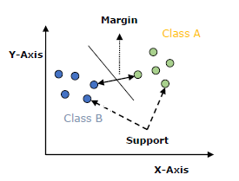
SVM-Working
An SVM model is basically a representation of different classes in a hyperplane in multidimensional space.
The hyperplane will be generated in an iterative manner by SVM so that the error can be minimized.
The goal of SVM is to divide the datasets into classes to find a maximum marginal hyperplane (MMH).

Slide 7

SVM-Working
The goal of the SVM algorithm is to create the best line or decision boundary that can segregate n-dimensional space into classes so that we can easily put the new data point in the correct category in the future. This best decision boundary is called a hyperplane.
SVM chooses the extreme points/vectors that help in creating the hyperplane.
These extreme cases are called as support vectors, and hence algorithm is termed as Support Vector Machine.

Slide 8
SVM Concept
Support Vectors − Data points that are closest to the hyperplane is called support vectors. Separating line will be defined with the help of these data points.
Hyperplane − It is a decision plane or space which is divided between a set of objects having different classes.
There can be multiple lines/decision boundaries to segregate the classes in n-dimensional space, but we need to find out the best decision boundary that helps to classify the data points.
This best boundary is known as the hyperplane of SVM.

Slide 9
SVM Concept
The dimensions of the hyperplane depend on the features present in the dataset, which means if there are 2 features, then hyperplane will be a straight line. And if there are 3 features, then hyperplane will be a 2-dimension plane.
We always create a hyperplane that has a maximum margin, which means the maximum distance between the data points.
Margin − It may be defined as the gap between two lines on the closet data points of different classes.
It can be calculated as the perpendicular distance from the line to the support vectors.
Large margin is considered as a good margin and small margin is considered as a bad margin.

Slide 10
Goal
The main goal of SVM is to divide the datasets into classes to find a maximum marginal hyperplane (MMH) and it can be done in the following two steps −
First, SVM will generate hyperplanes iteratively that segregates the classes in best way.
Then, it will choose the hyperplane that separates the classes correctly.

Slide 11
Example
Example: SVM can be understood with the example .
Suppose we see a strange cat that also has some features of dogs, so if we want a model that can accurately identify whether it is a cat or dog, so such a model can be created by using the SVM algorithm.
We will first train our model with lots of images of cats and dogs so that it can learn about different features of cats and dogs, and then we test it with this strange creature.
So as support vector creates a decision boundary between these two data (cat and dog) and choose extreme cases (support vectors), it will see the extreme case of cat and dog.
On the basis of the support vectors, it will classify it as a cat.
Consider the diagram in next slide

Slide 12
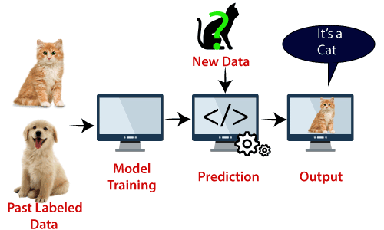
Example

Slide 13
Types
SVM can be of two types:
Linear SVM: Linear SVM is used for linearly separable data, which means if a dataset can be classified into two classes by using a single straight line, then such data is termed as linearly separable data, and classifier is used called as Linear SVM classifier.
Non-linear SVM: Non-Linear SVM is used for non-linearly separated data, which means if a dataset cannot be classified by using a straight line, then such data is termed as non-linear data and classifier used is called as Non-linear SVM classifier.

Slide 14
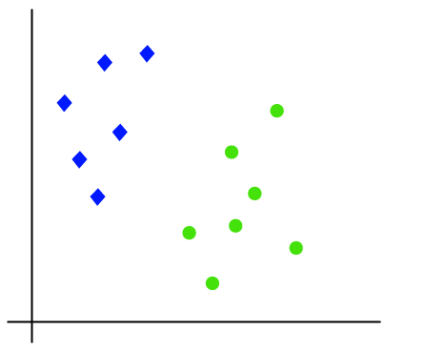
Linear SVM
The working of the SVM algorithm can be understood by using an example. Suppose we have a dataset that has two tags (green and blue), and the dataset has two features x1 and x2. We want a classifier that can classify the pair(x1, x2) of coordinates in either green or blue.

Slide 15
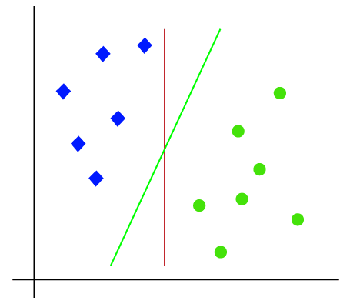
Linear SVM
So as it is 2-d space so by just using a straight line, we can easily separate these two classes. But there can be multiple lines that can separate these classes.

Slide 16
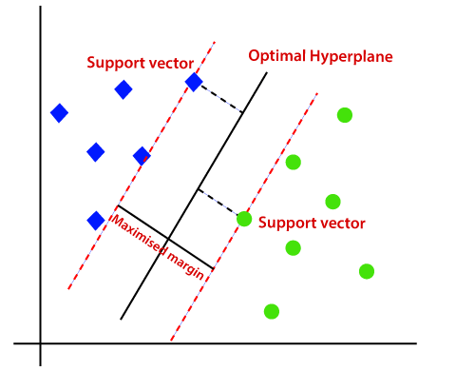
Linear SVM
Hence, the SVM algorithm helps to find the best line or decision boundary; this best boundary or region is called as a hyperplane.
SVM algorithm finds the closest point of the lines from both the classes.
These points are called support vectors.
The distance between the vectors and the hyperplane is called as margin.
And the goal of SVM is to maximize this margin.
The hyperplane with maximum margin is called the optimal hyperplane.

Slide 17
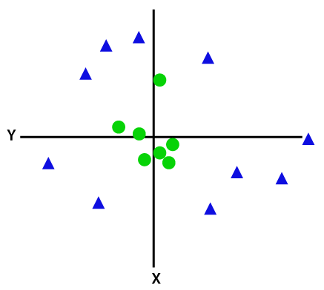
Non-Linear SVM
If data is linearly arranged, then we can separate it by using a straight line, but for non-linear data, we cannot draw a single straight line.

Slide 18
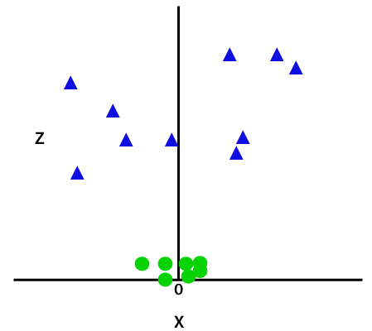

Non-Linear SVM
So to separate these data points, we need to add one more dimension. For linear data, we have used two dimensions x and y, so for non-linear data, we will add a third dimension z. It can be calculated as:
$x^{2}+y^{2}=z^{2}$
By adding third dimension

Slide 19
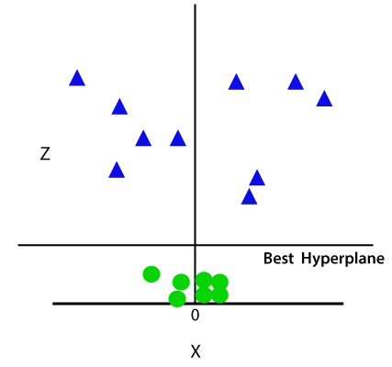
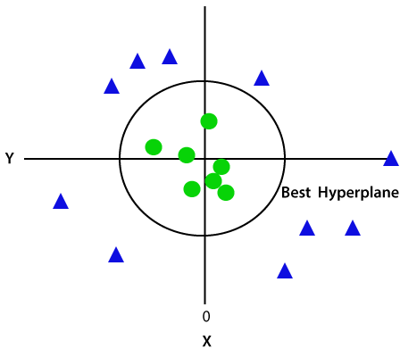
Non-Linear SVM
So now, SVM will divide the datasets into classes in the following way
Hence we get a circumference of radius 1 in case of non-linear data.
Since we are in 3-d Space, hence it is looking like a plane parallel to the x-axis. If we convert it in 2d space with z=1, then it will become as

Slide 20
SVM Kernels
In practice, SVM algorithm is implemented with kernel that transforms an input data space into the required form.
SVM uses a technique called the kernel trick in which kernel takes a low dimensional input space and transforms it into a higher dimensional space.
In simple words, kernel converts non-separable problems into separable problems by adding more dimensions to it.
It makes SVM more powerful, flexible and accurate.
The following are some of the types of kernels used by SVM.
Linear
Polynomial
Radial Basis

Slide 21
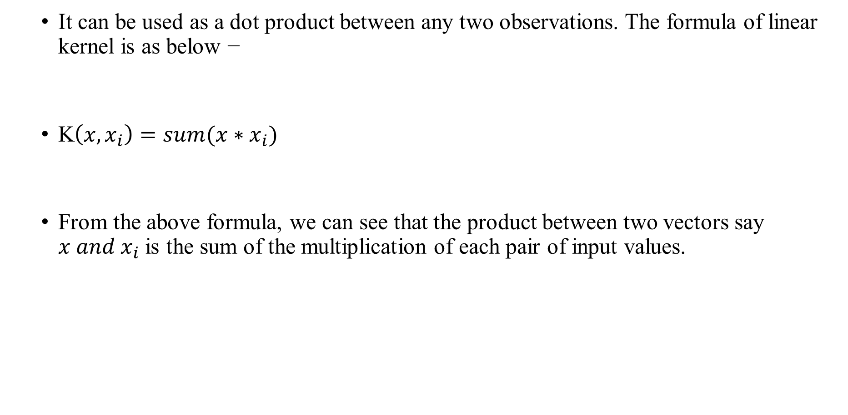
Linear Kernel
It can be used as a dot product between any two observations. The formula of linear kernel is as below −
K$\left(x,x_{i}\right)=sum(x∗x_{i})$
From the above formula, we can see that the product between two vectors say $x and x_{i}$ is the sum of the multiplication of each pair of input values.

Slide 22
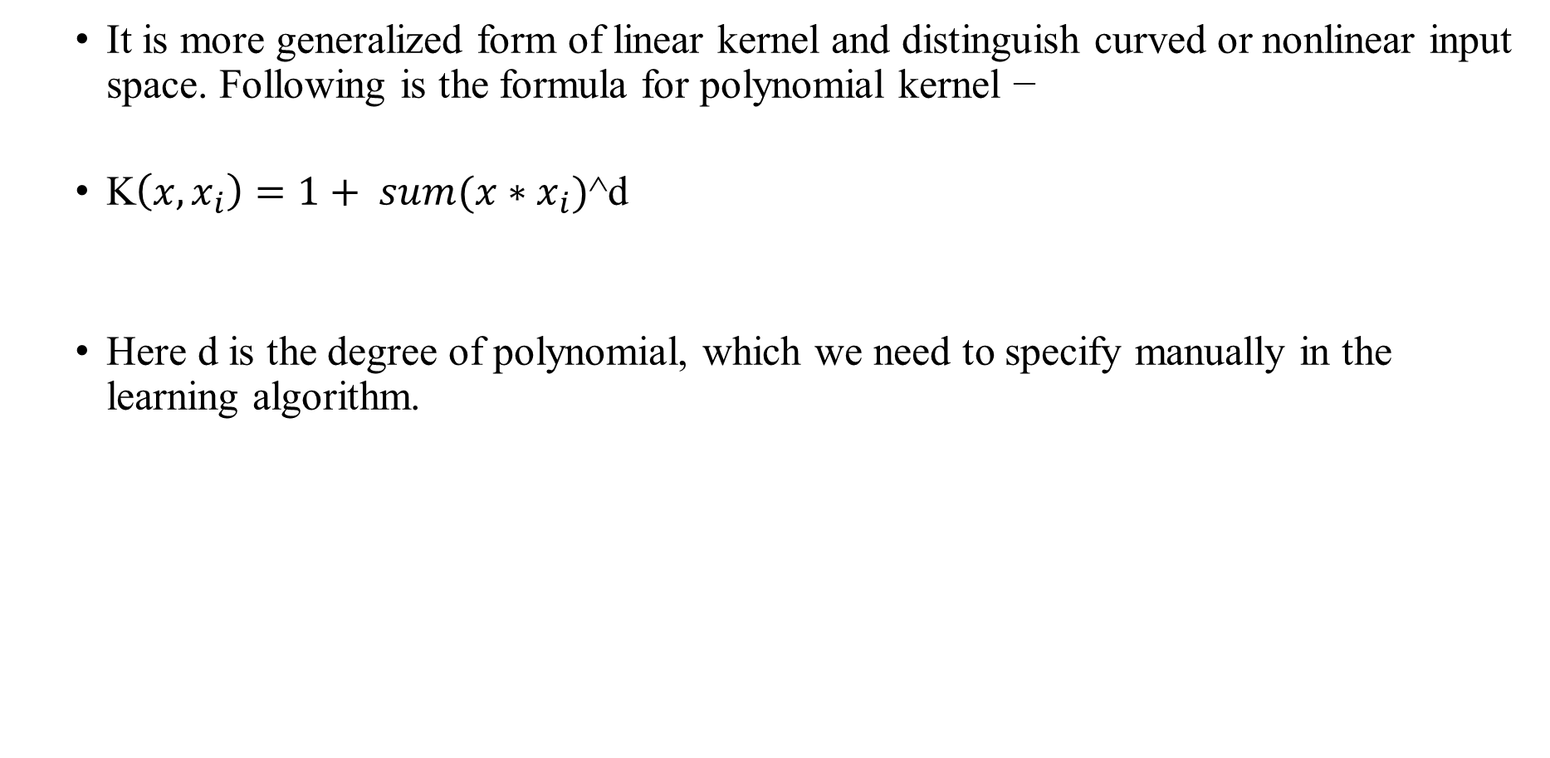
Polynomial Kernel
It is more generalized form of linear kernel and distinguish curved or nonlinear input space. Following is the formula for polynomial kernel −
K$\left(x,x_{i}\right)=1+ sum(x∗x_{i})$^d
Here d is the degree of polynomial, which we need to specify manually in the learning algorithm.

Slide 23
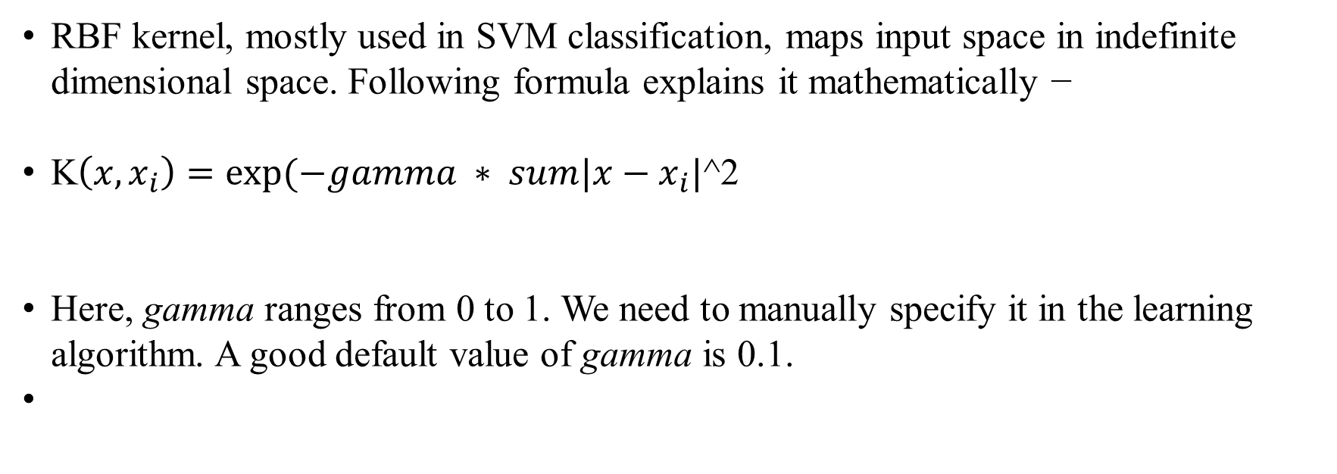
Radial Basis Function (RBF)
RBF kernel, mostly used in SVM classification, maps input space in indefinite dimensional space. Following formula explains it mathematically −
K$\left(x,x_{i}\right)=exp⁡(−gamma ∗ sum|x−x_{i}|$^2
Here, gamma ranges from 0 to 1. We need to manually specify it in the learning algorithm. A good default value of gamma is 0.1.

Slide 24
Pros
It is really effective in the higher dimension.
Effective when the number of features are more than training examples.
Best algorithm when classes are separable
The hyperplane is affected by only the support vectors thus outliers have less impact.
SVM is suited for extreme case binary classification.

Slide 25
Cons
For larger dataset, it requires a large amount of time to process.
Does not perform well in case of overlapped classes.
Selecting, appropriately hyperparameters of the SVM that will allow for sufficient generalization performance.
Selecting the appropriate kernel function can be tricky.

Slide 26
References
Books and Journals
Understanding Machine Learning: From Theory to Algorithms by Shai Shalev-Shwartz and Shai Ben-David-Cambridge University Press 2014
Introduction to machine Learning – the Wikipedia Guide by Osman Omer.
Video Link-
https://www.youtube.com/watch?v=9f-GarcDY58
https://www.youtube.com/watch?v=GwIo3gDZCVQ
Web Link-
https://towardsdatascience.com/support-vector-machines-svm-c9ef22815589
https://beingdatum.com/getting-friendly-with-svm-algorithm/
https://www.tutorialspoint.com/machine_learning_with_python/machine_learning_with_python_classification_algorithms_support_vector_machine.htm

Slide 27
THANK YOU

